Slide 1
JAVA PROJECT BATCH
GUI Programming
Lecture 5

Slide 2
Table Of Contents
01.
Centring The JFrame
02.
Changing Icons in JFrame
03.
Adding component to JFrame
04.
Event Handling in Netbeans

Slide 3


Centering the JFrame on Desktop
Almost every standard application opens its main window at the center of desktop.
In our case if we observe the frame is opening on top left corner.
To change this behavior and bring the frame at the center we must call the method
setLocationRelativeTo passing it null as the argument.
Example-
public MyJFrame() {
initComponents();
this.setLocationRelativeTo(null);
}
Now ,run the code and you will get the output at the center of the desktop.

Slide 4
Changing Icon In Jframe
To change the icon on JFrame we have to call the method setIconImage( ) of JFrame class .
The prototype of the method is:
public void setIconImage(Image)
The argument passed to this method is an object of Image class which is available in java.awt package. But to create an object of Image class we have to use the Toolkit
class.

Slide 5
Steps Needed To Change The Image
Create an object of Toolkit class by calling it's static method called getDefaultToolkit().
It's prototype is:
public static Toolkit getDefaultToolkit( )
2. Using the Toolkit object call it's method getImage() which will return us an Image object.
It's prototype is:
public Image getImage(String imagepath)
3.Pass the Image object as argument to the method setIconImage( ) of the class JFrame.
It's prototype is:
public void setIconImage(Image obj)

Slide 6
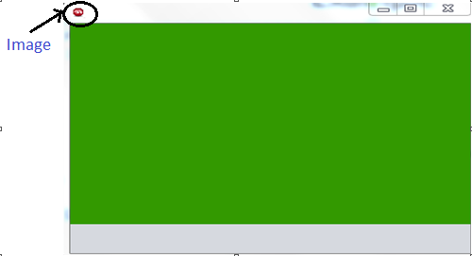
Example
public class MyJFrame extends javax.swing.Jframe
{
public MyJFrame() {
initComponents();
this.setLocationRelativeTo(null);
Toolkit t=Toolkit.getDefaultToolkit();
Image img=t.getImage("C:/Users/Server/Desktop/Download/images.jpg“);
this.setIconImage(img);
}
Output-

Slide 7
Adding Components to JFrame
The “JButton” class:
Properties Of "JButton" class
1. text: For setting the text on JButton
2. icon: For setting image on JButton
3. font: For changing font of the JButton
4. background: For changing the background color of JButton
5. foreground: For changing the font color of JButton
Methods Of "JButton" class:
1. public Icon getIcon ( )
2. public void setIcon(Icon)
3. public void setText(String)
4. public String getText( )
5. public void setToolTipText(String)

Slide 8
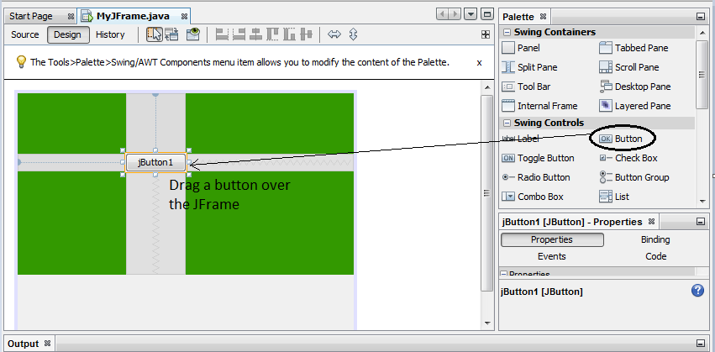
Adding Components to JFrame
1. Start by selecting a Button from the Palette and drop it onto the JFrame.

Slide 9
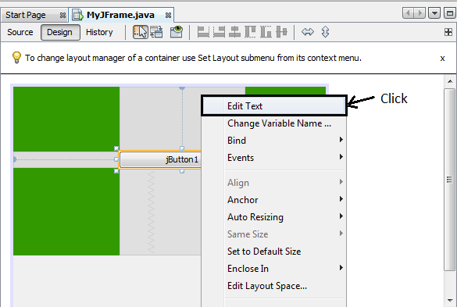
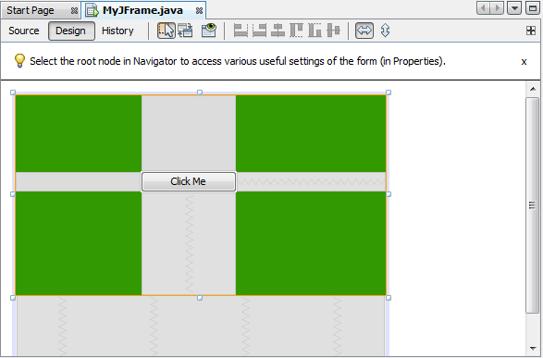
Adding Components to JFrame
2. To change the text on button right click on button and then click on Edit text and
rename it.
Output:-

Slide 10
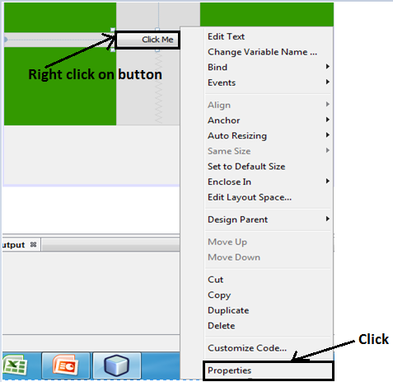
Set Icon on Button on Design time
To setIcon on button we have two options either have design time or through runtime.
Design Time: to change the icon on design time select the button make a right click ,click on properties.

Slide 11
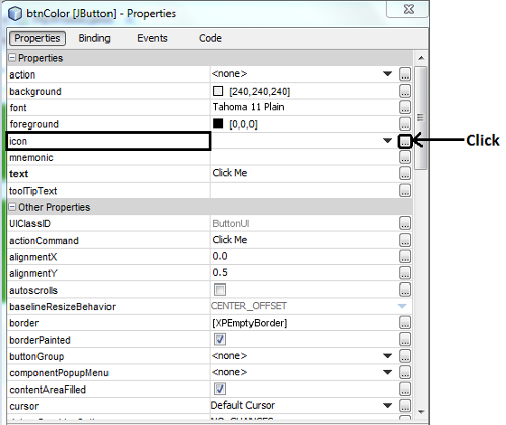
Set Icon on Button on Design time
2. In the Properties window, click the Properties category and scroll to the Icon property.

Slide 12
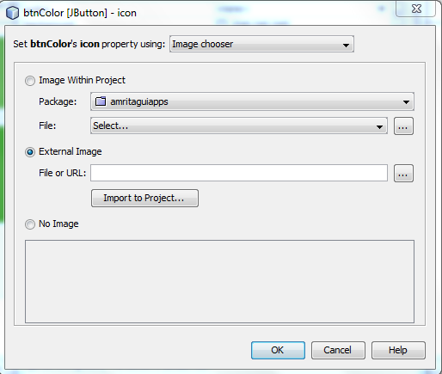
Set Icon on Button on Design time
3.Click the ellipsis (...) button. The icon property editor is displayed as below.

Slide 13
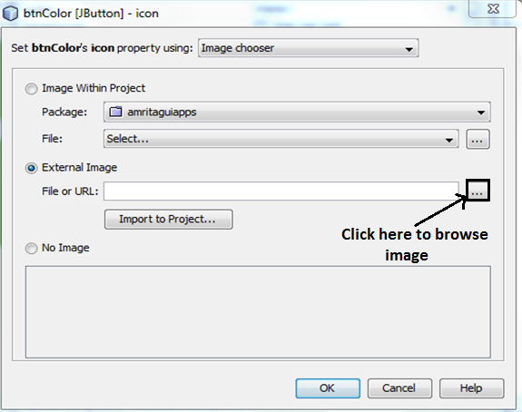
Set Icon on Button on Design time
4. In the icon property dialog box, click External Image . In the file chooser navigate to any image that is on your system that you want to use.

Slide 14
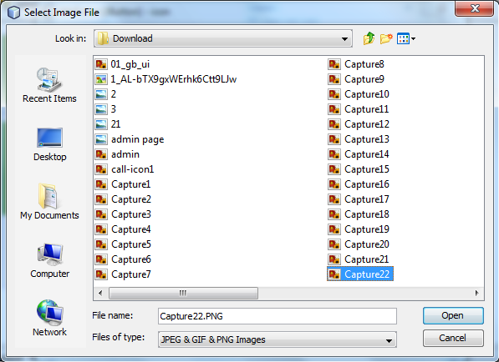
Set Icon on Button on Design time
5. Select an image then click on open.

Slide 15
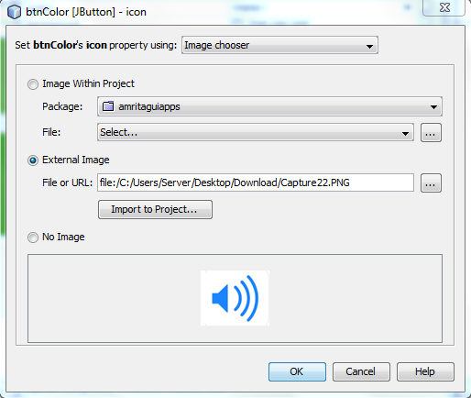
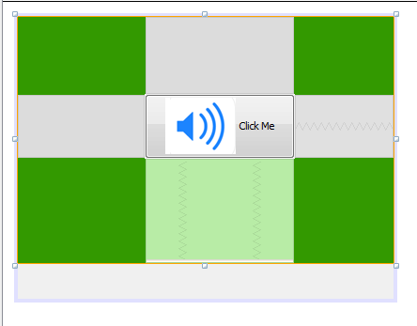
Set Icon on Button on Design time
6. Click OK to close the icon property dialog box.
Output:

Slide 16
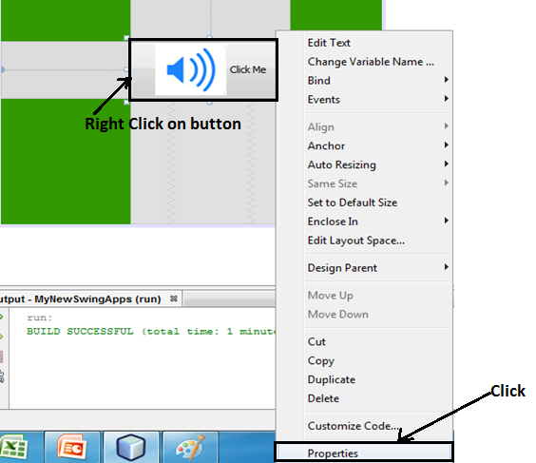
How to setToolTipText(String)
To set the setToolTipText select the button and make a right click , then click on properties.

Slide 17
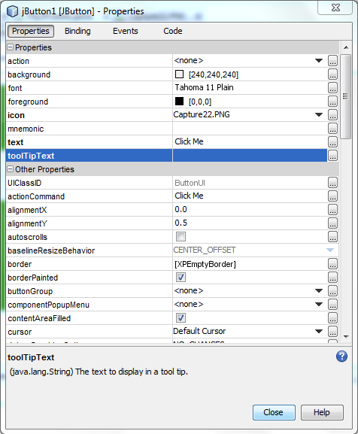
How to setToolTipText(String)
2. In the Properties window, click the Properties category and scroll to the toolTipText property.

Slide 18
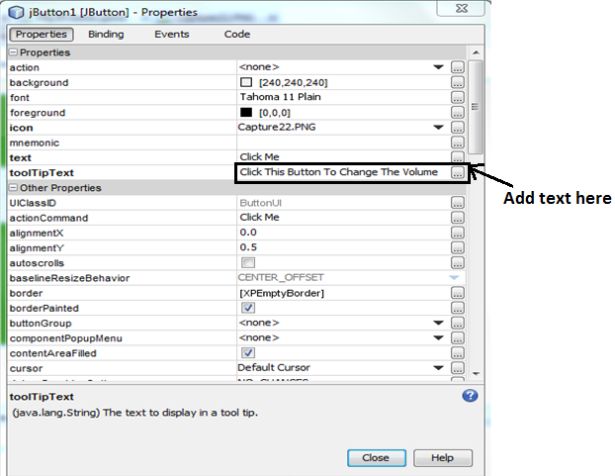
How to setToolTipText(String)
3. To add toolTipText to button, you have to add only a text, which is in our case is “Click This Button To Change The Volume” and then click on close.

Slide 19
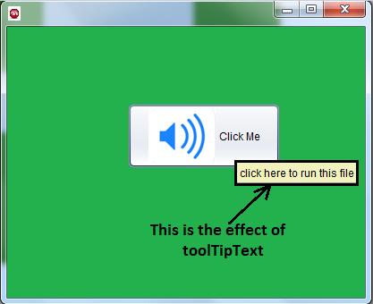
How to setToolTipText(String)
4. Here is the output of the tool tip that appears when the cursor pauses over the button.

Slide 20
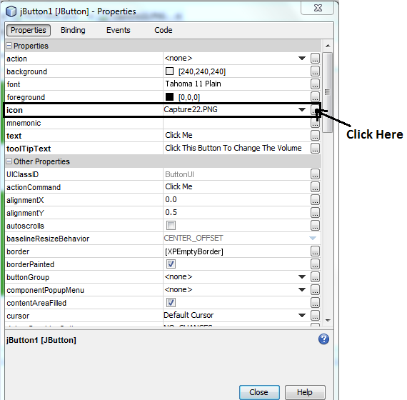
Set Icon on Button through Code Window
Firstly remove the image icon by make a right click on button, then click on properties and scroll to the icon property.

Slide 21
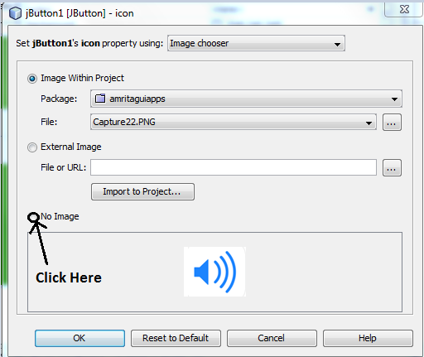
Set Icon on Button through Code Window
2. Click on no image and then click on ok.

Slide 22
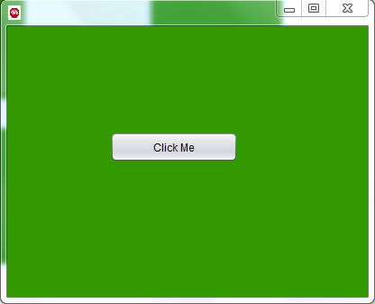
Set Icon on Button through Code Window
3. Here is the output,Image is removed.

Slide 23
Set Icon on Button through Code Window
Example -
public MyJFrame()
{
initComponents();
this.setLocationRelativeTo(null);
Toolkit t=Toolkit.getDefaultToolkit();
Image img=t.getImage("C:/Users/Server/Desktop/Download/images.jpg");
this.setIconImage(img);
ImageIcon icon=new ImageIcon("C:/Users/Server/Desktop/Download/image4.png");
btnColor.setIcon(icon);
}

Slide 24
Set Icon on Button through Code Window
Note:- Java or netbeans recommends name of button should be start with btn .
Example -
public MyJFrame()
{
initComponents();
this.setLocationRelativeTo(null);
Toolkit t=Toolkit.getDefaultToolkit();
Image img=t.getImage("C:/Users/Server/Desktop/Download/images.jpg");
this.setIconImage(img);
ImageIcon icon=new ImageIcon("C:/Users/Server/Desktop/Download/image4.png");
btnColor.setIcon(icon);
}
Note:- Java or netbeans recommends name of button should be start with btn .

Slide 25
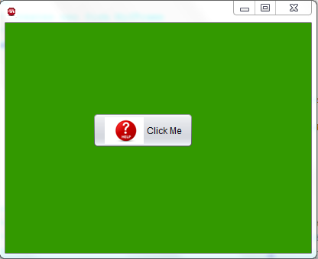
Output
Here is the output:

Slide 26
Handling Events in Netbeans
In netbeans event handling requireds very minimum coding compare to normal approach of event handling. In netbeans we do not have to implement any event
interface ourself, we do not have to overwrite specific methods like actionPerformed or mouse click and neither we have to perform registration of source or listener .
We just have to do one thing which is provide our own logic for event method
generated by netbeans.
For Example→ To handle button click we take following steps:
Right click the button
Go to Events option select Action→actionPerformed and click so that a blank
skeleton gets generated.
3. Finally we have to write our own code in the method.

Slide 27
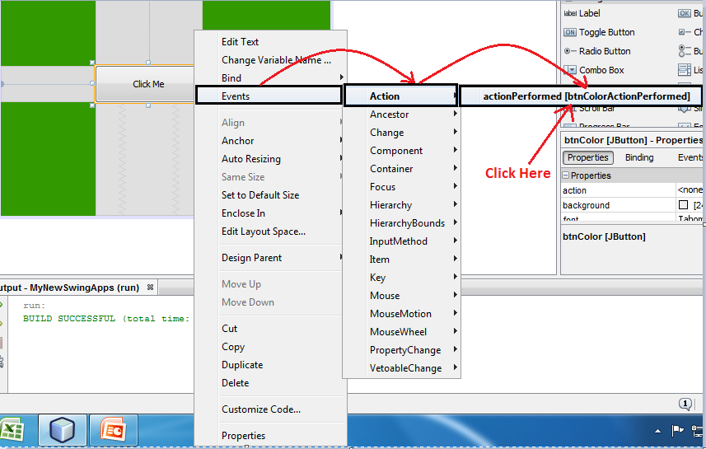
Handling Events in Netbeans

Slide 28
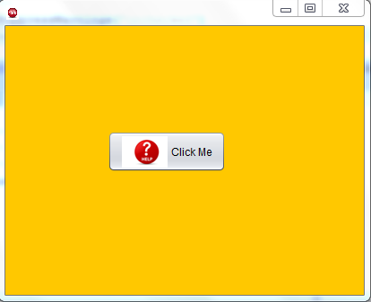
Example
Change the background color on button click.
Solution:-
private void btnColorActionPerformed(java.awt.event.ActionEvent evt)
{ (Netbeans Method)
jpMainPanel.setBackground(Color.ORANGE);
}
Output:-

Slide 29
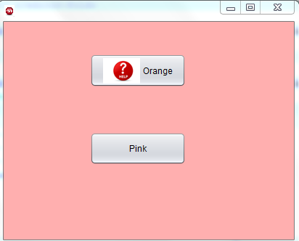
Example
For multiple button multiple methods will be called.
For Example:-
private void btnColorActionPerformed(java.awt.event.ActionEvent evt) {
jpMainPanel.setBackground(Color.orange);
}
private void jButton1ActionPerformed(java.awt.event.ActionEvent evt) {
jpMainPanel.setBackground(Color.pink);
}
Output:-

Slide 30


